Slide 1
Suffix Trees
Akshat Mittal
2000101011

Slide 2
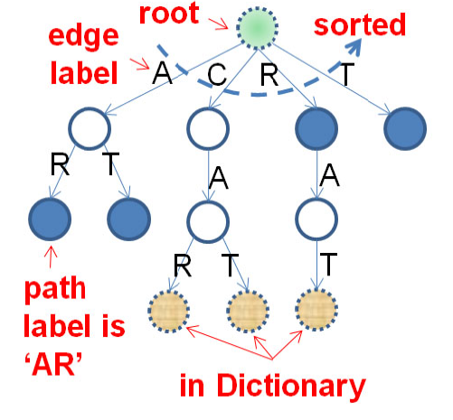
Suffix trie
A Suffix Trie of a set of strings S is a tree of all possible suffixes of strings in S. Each edge label represents a character.
Each vertex represents a suffix indicated by its path label: A sequence of edge labels from root to that vertex.
Each vertex is connected to (some of) the other vertices according to the suffixes of strings in S.
The common prefix of two suffixes is shared.
Each vertex has a boolean flag to indicate that there exists a suffix in S terminating in that vertex, respectively.
Suffix Trie formed by using the words {RAT, CAT and CART}.

Slide 3
Suffix TREE
Why a new data structure?
Suffix Tree
Suffix Tries can also do all the search operations but are costly to store (O(N²)).
We need to remove the redundant nodes in the trie to make it more efficient.
In suffix Trees, we don’t actually have the redundant nodes and we directly merge the nodes in the suffix trie which have only one children.
The number of nodes in a suffix trie is bounded by O(N).
Storing the edges could be costly so we represent them as start and end points in the original string.
To store a string, we have a general rule to add a special symbol ‘$’ to the end of the string to avoid losing any small suffix which is also a prefix of another larger suffix.

Slide 4
INSERTION
A root node is created for the tree.
The input string is iterated character by character.
For each character, a new suffix is formed by considering the substring that starts from that character and extends to the end of the string.
A search is performed for the longest prefix of the suffix that is already present in the tree.
If a matching prefix is found, the traversal continues along the corresponding edge until a point is reached where the suffix differs from the edge label.

Slide 5
INSERTION
At this point, a new internal node is created that represents the longest common prefix, and two new edges are added: one going from the parent node to the new internal node, labeled with the common prefix, and one going from the internal node to a new leaf node, labeled with the remaining suffix.
If no matching prefix is found, a new leaf node is created, labeled with the entire suffix, and it is added as a child of the current node.
The resulting suffix tree is a compact representation of all the suffixes of the input string.

Slide 6
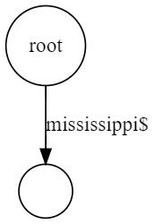
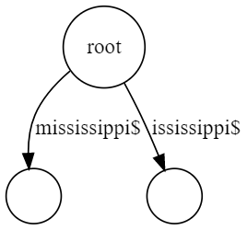
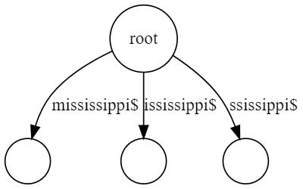
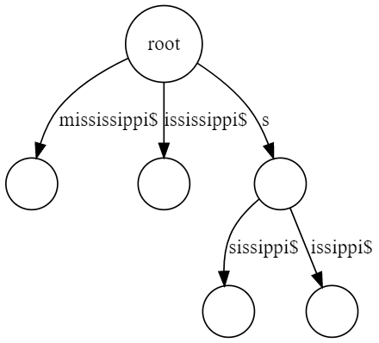
ILLUSTRATION
Say, we have to make a suffix tree for string: mississippi$
Adding the first substring “mississippi$”.
Adding the substring “ississippi$”.
Adding the substring “ssissippi$”.
Adding the substring “sissippi$”.

Slide 7
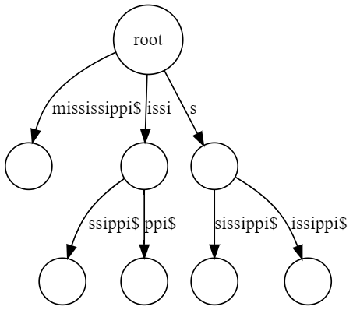
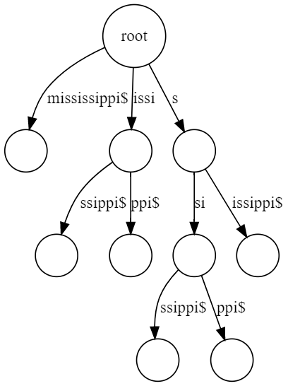
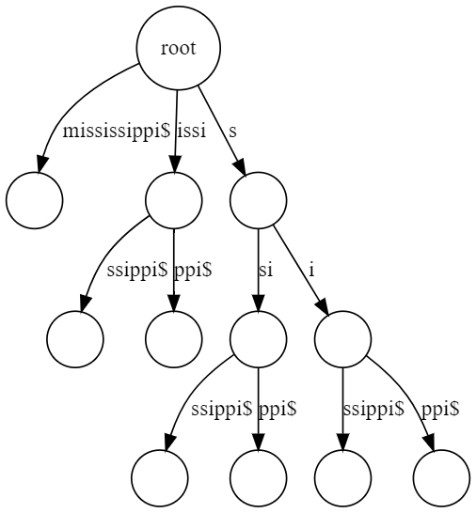
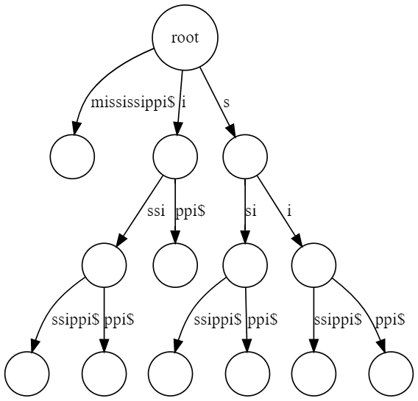
ILLUSTration
Adding the substring “issippi$”.
Adding the substring “ippi$”.
Adding the substring “ssippi$”.
Adding the substring “sippi$”.

Slide 8
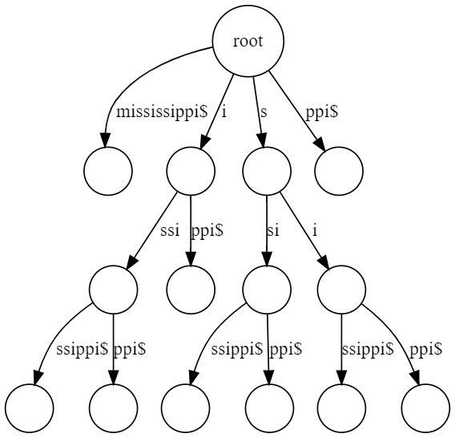
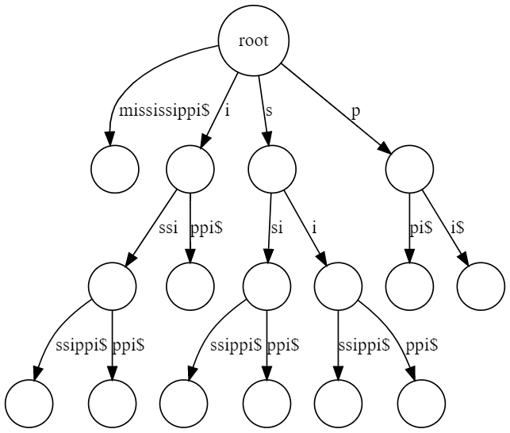
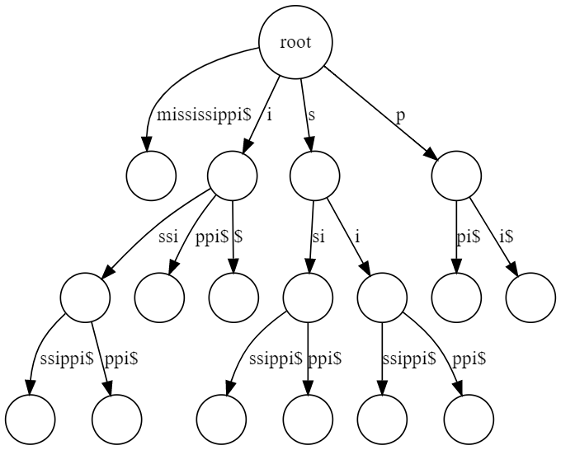
illustration
Adding the substring “ppi$”.
Adding the substring “pi$”.
Adding the substring “i$”.

Slide 9
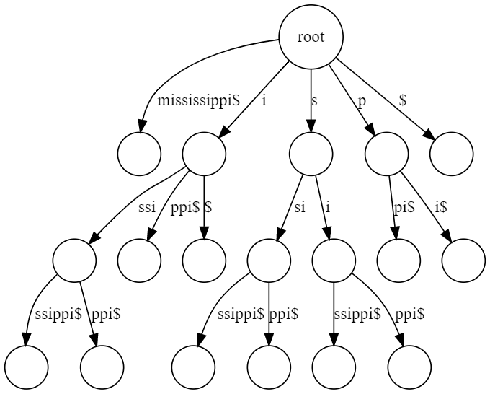
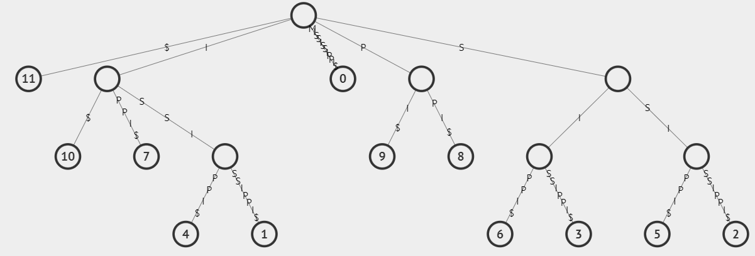
Illustration – Final Tree

Slide 10
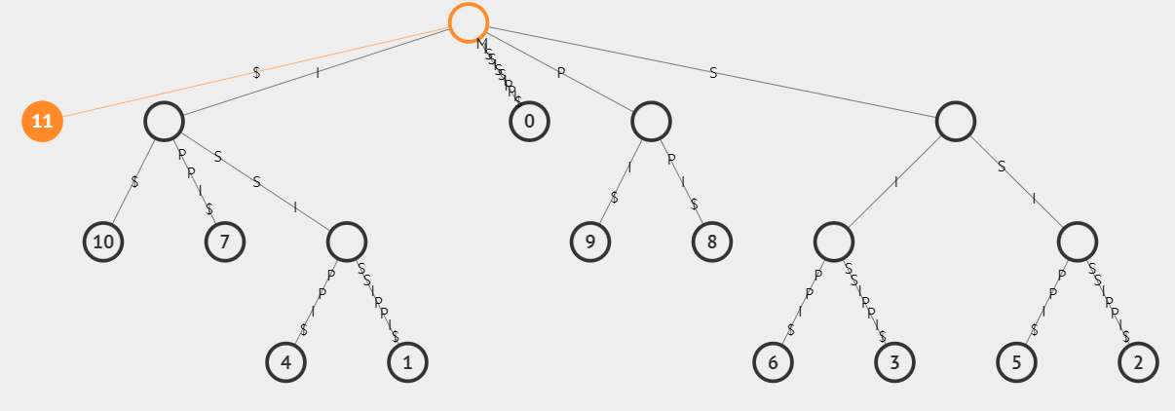
searching
Say, we have to search for the string “ssip” in current tree.
We have to visit each child until we find a match.

Slide 11
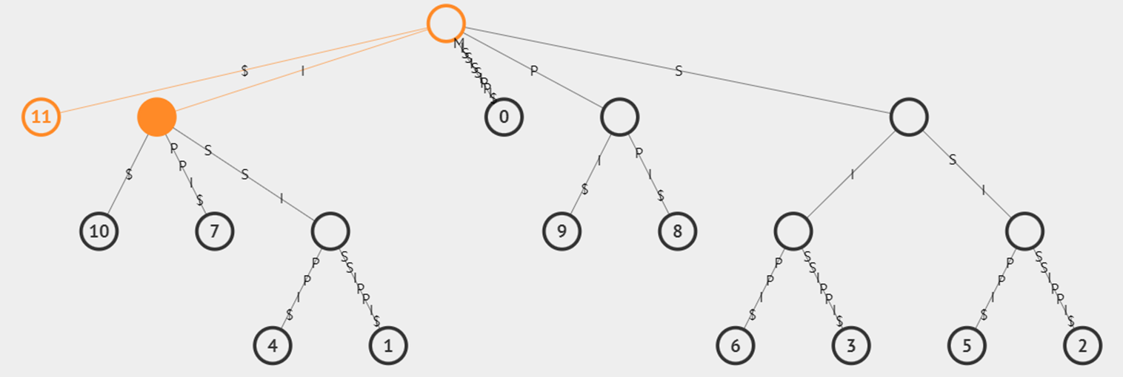
searching
Say, we have to search for the string “ssip” in current tree.
We have to visit each child until we find a match.

Slide 12
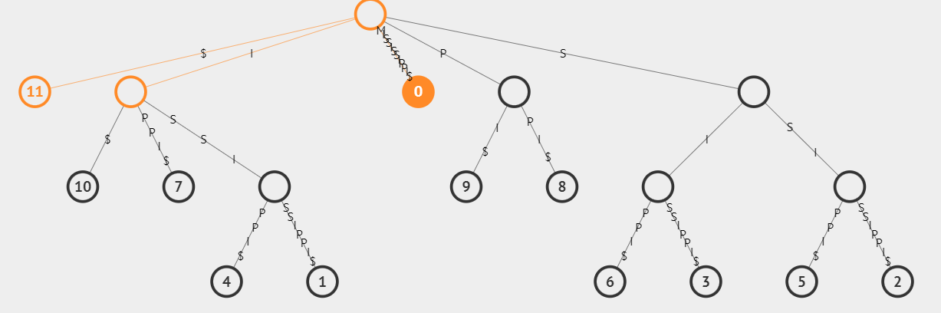
searching
Say, we have to search for the string “ssip” in current tree.
We have to visit each child until we find a match.

Slide 13
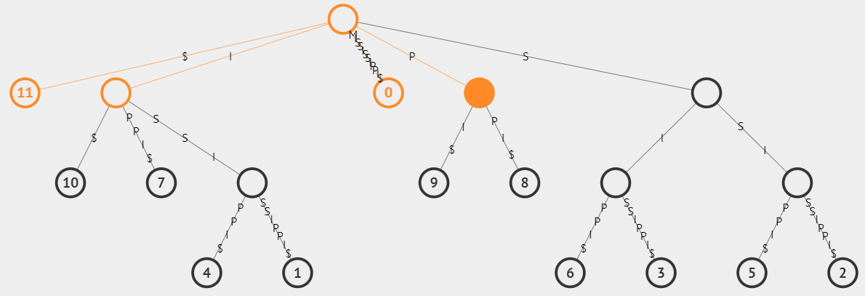
searching
Say, we have to search for the string “ssip” in current tree.
We have to visit each child until we find a match.

Slide 14
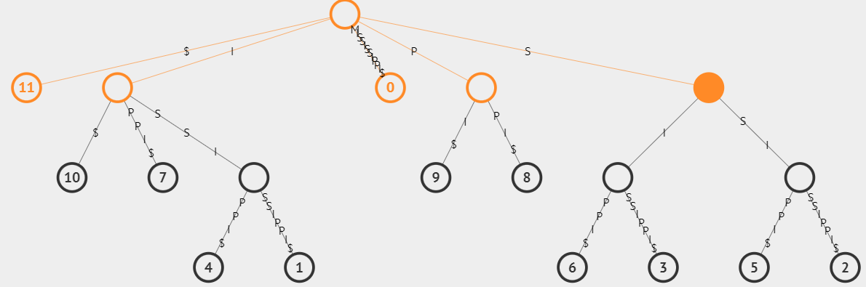

searching
Say, we have to search for the string “ssip” in current tree.
We have to visit each child until we find a match.
Match Found!

Slide 15
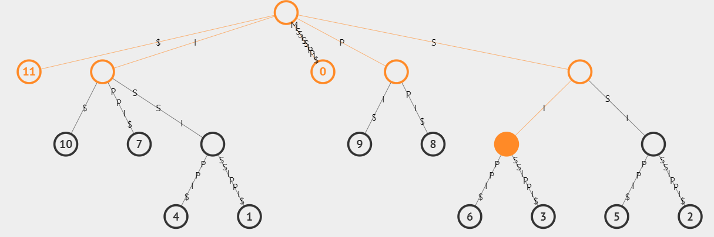
searching
Say, we have to search for the string “ssip” in current tree.
We have to visit each child until we find a match.

Slide 16
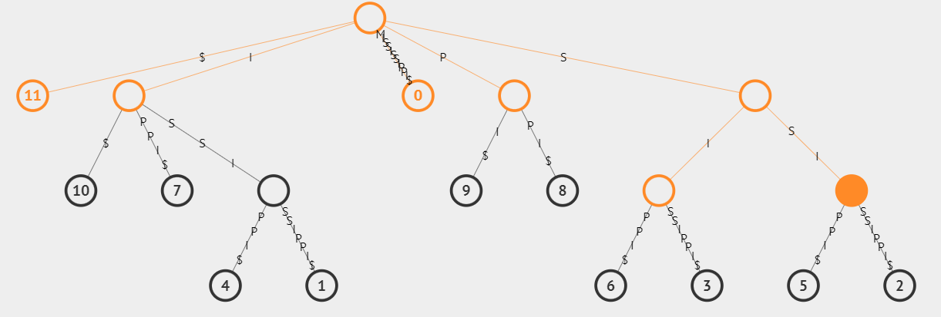
searching
Say, we have to search for the string “ssip” in current tree.
We have to visit each child until we find a match.
Match Found!

Slide 17
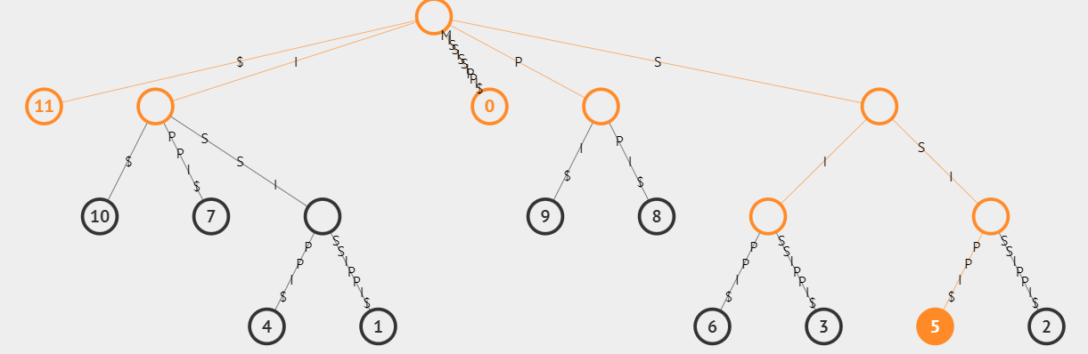

searching
Say, we have to search for the string “ssip” in current tree.
We have to visit each child until we find a match.
String Found!

Slide 18
Thank You

